Slide 1
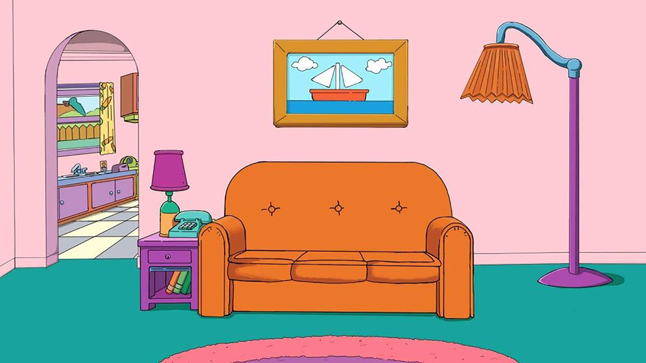

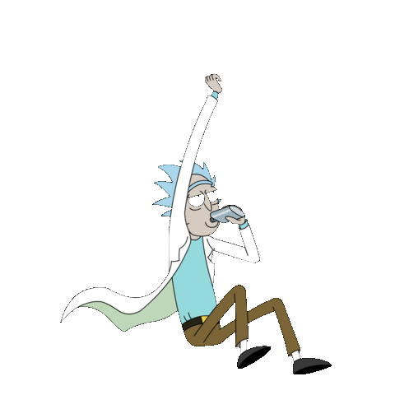
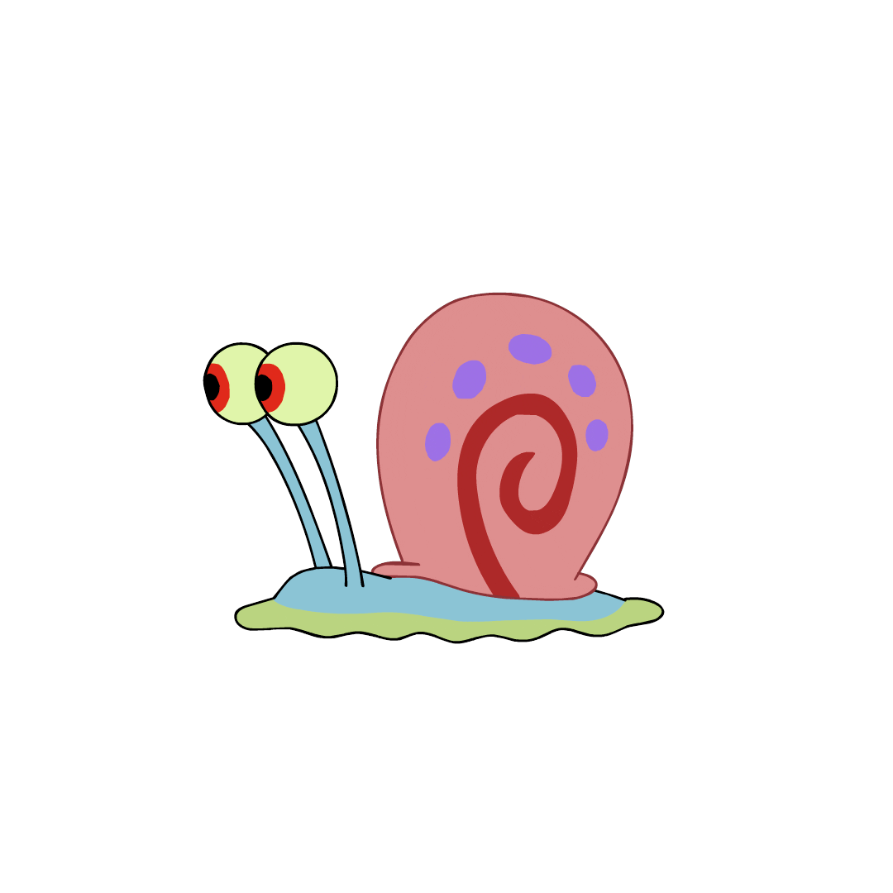
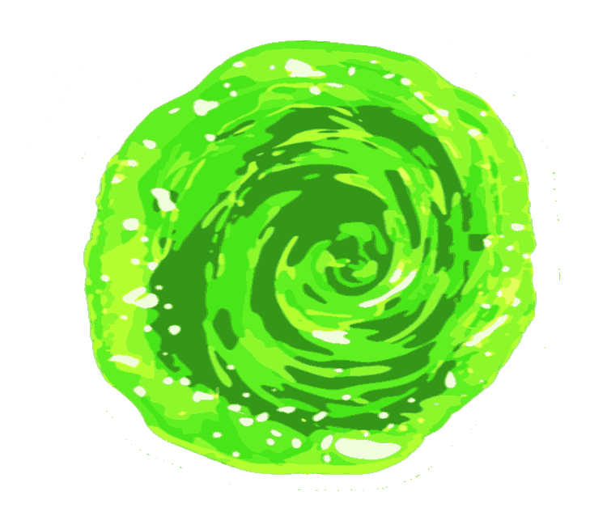

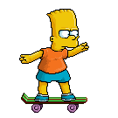
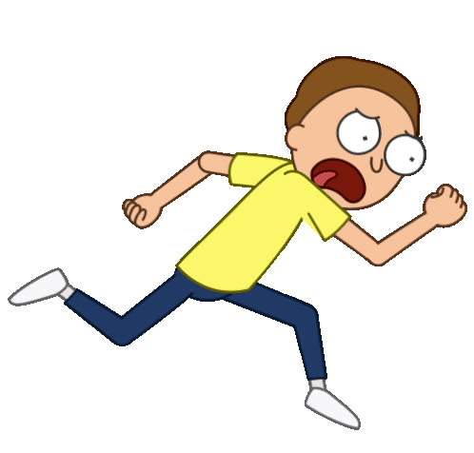

kpeter72
THEN CLICK ON THE NAVIGATION BUTTON TO SEE MY FAVOURITE ANIMATED MOVIES !
The portal brought the characters to the website. Let’s first explore animation history…
Welcome To My Website !

